Slide 1
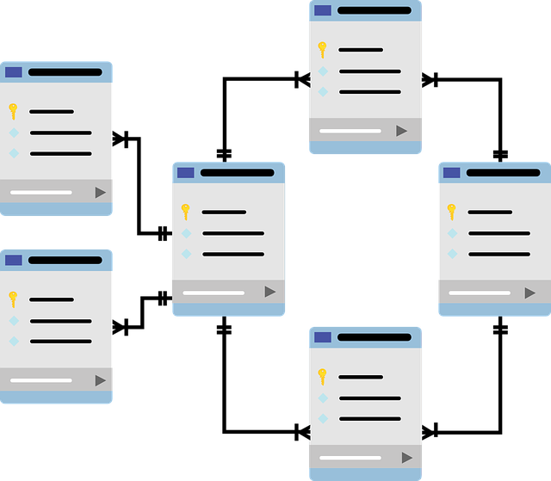
Database Design for Car Company Management
Overview of Tables and Relationships
KALEESWARAN M
C99-FS-P-B1-99

Slide 2
Introduction
Objective:
To manage the car company's data efficiently, including customers, employees, sales, services, inventory,
Key Features:
Tracks cars, customers, and employees.
Manages sales, services, feedback, and insurance.
Organizes branches and stock details.

Slide 3
Database Schema Overview
Entities (Tables):
Car Table
Customer Table
Employee Table
Sales Table
Service Table
Manufacturer Table
Insurance Table
Feedback Table
Branch Table
Stock Table

Slide 4
Tables overview
Car Table:
Stores information about cars, including models, price, year, and fuel type.
Customer Table:
Holds customer details like name, contact, DOB, and address.
Employee Table:
Manages employee data such as branch, position, and salary.
Sales Table:
Links cars, customers, and employees to track car sales.
Service Table:
Tracks services provided to customers' cars, including cost and type.
Manufacturer Table:
Stores manufacturer details like company name, country, and contact.
Insurance Table:
Tracks car insurance policies, including start and end dates.
Feedback Table:
Stores customer feedback and ratings.
Branch Table:
Contains branch-specific details such as location and contact.
Stock Table:
Tracks car inventory at each branch.

Slide 5
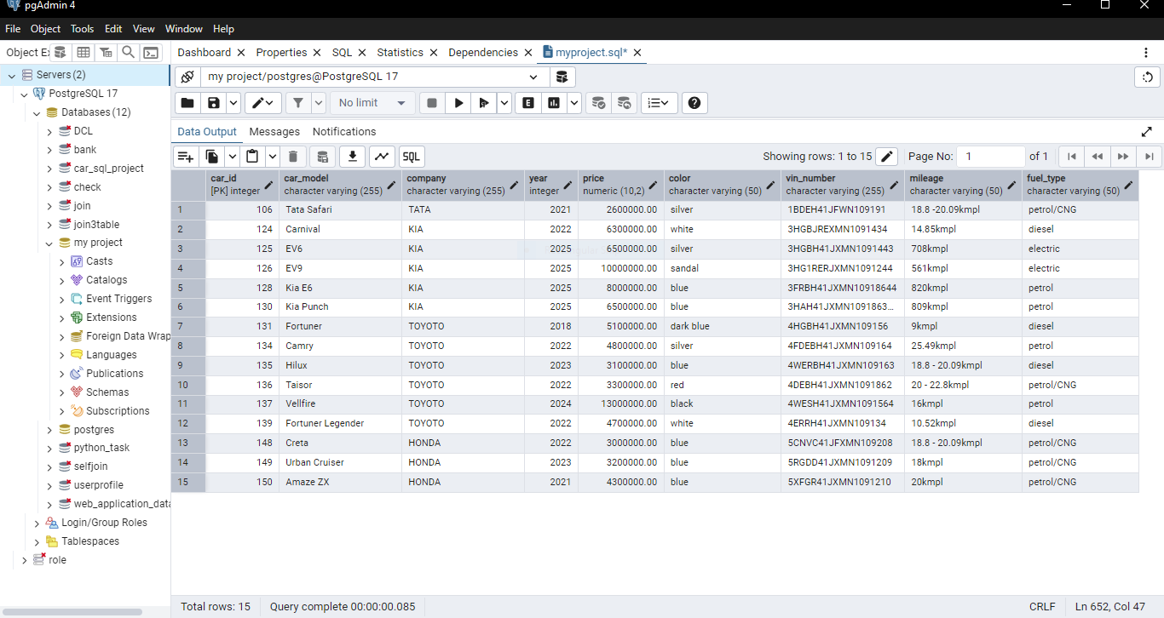
LOGICS OVERVIEW
Cars Above ₹25 Lakhs:
SELECT * FROM car_table WHERE price > 2500000;
Displays premium cars priced above ₹25 Lakhs.

Slide 6
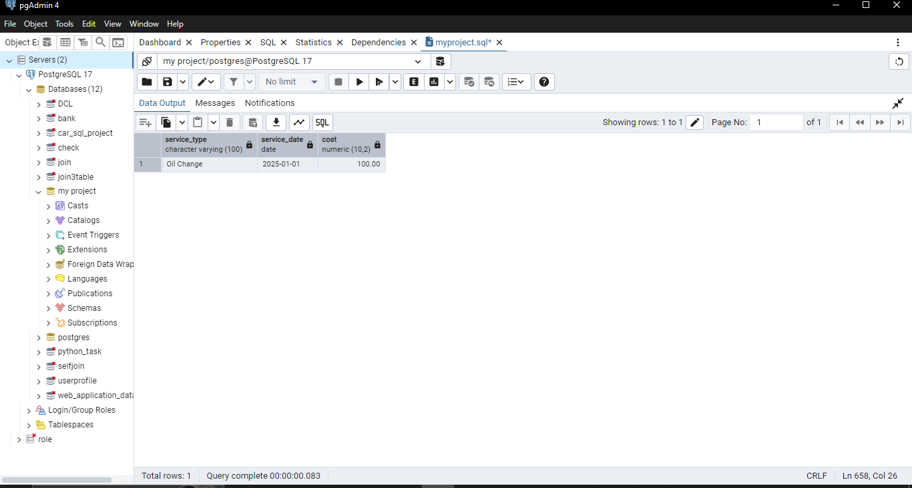
Customer's Service Details:
SELECT service_type, service_date, cost FROM service_table WHERE customer_id = 201;
Tracks services for a specific customer.

Slide 7
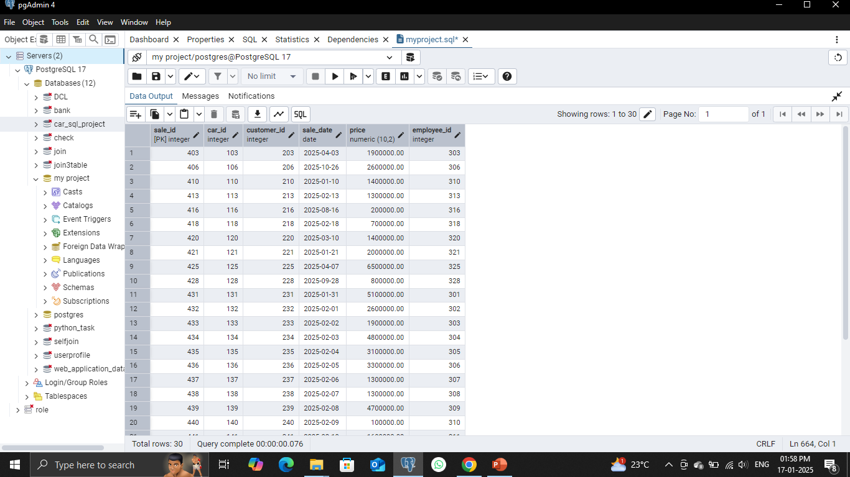
Maximum Cars Delivered in 2025:
SELECT * FROM sales_table WHERE DATE_PART('year', sale_date) = 2025;
Identifies car sales for the year 2025

Slide 8
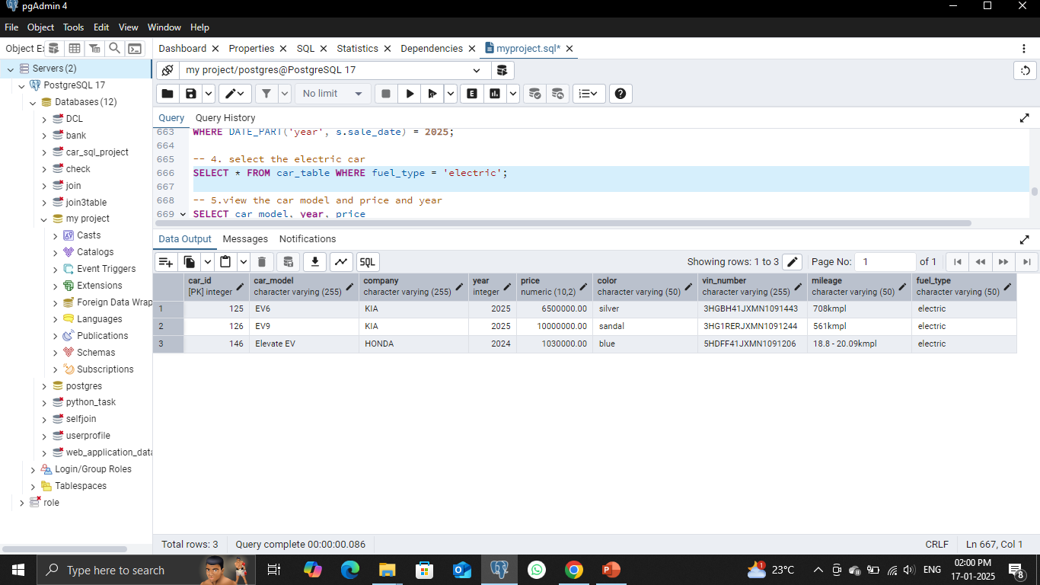
Electric Cars Only:
SELECT * FROM car_table WHERE fuel_type = 'electric’;
Lists all available electric cars.

Slide 9
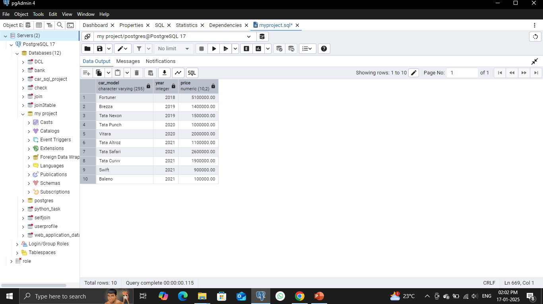
Car Models, Price, and Year (First 10):
SELECT car_model, year, price FROM car_table ORDER BY year ASC LIMIT 10;
Displays car details sorted by year.

Slide 10
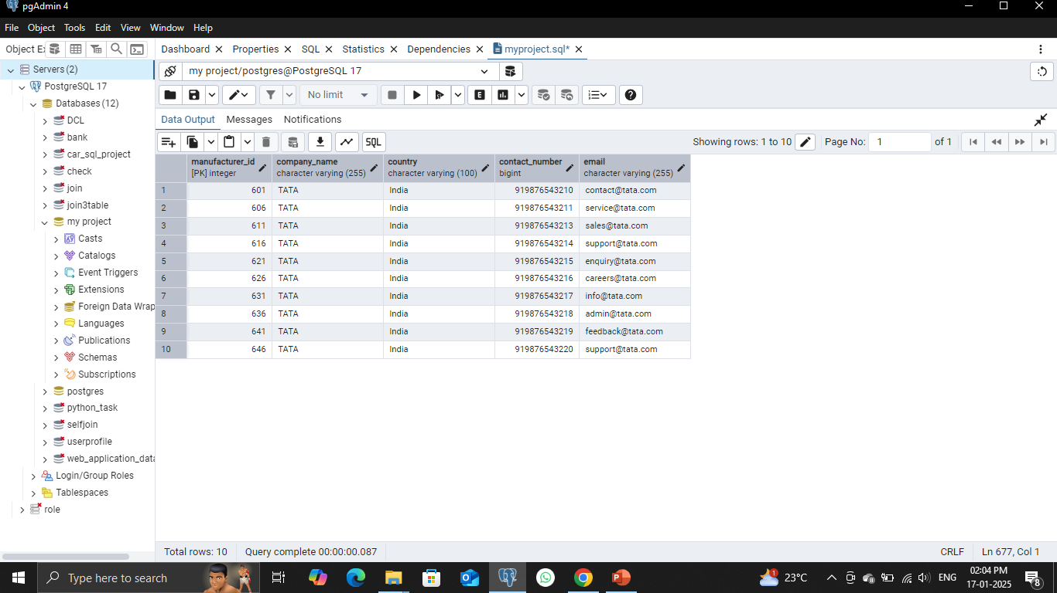
Manufacturers:
SELECT * FROM manufacturer_table WHERE company_name = 'TATA’;
Fetches all TATA manufacturer details.

Slide 11
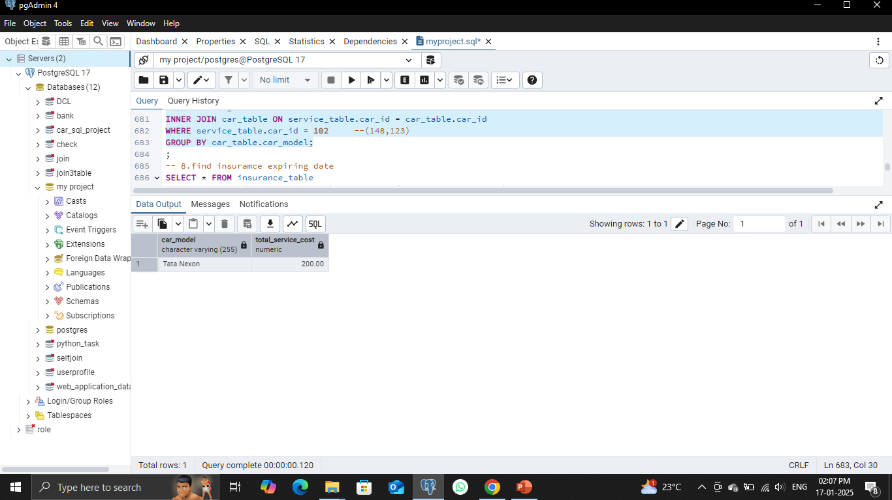
Car Service Cost by Model:
SELECT car_model, SUM(cost) AS total_service_cost FROM service_table JOIN car_table ON service_table.car_id = car_table.car_id WHERE service_table.car_id = 102 GROUP BY car_model;
Calculates service cost for a specific car model.

Slide 12
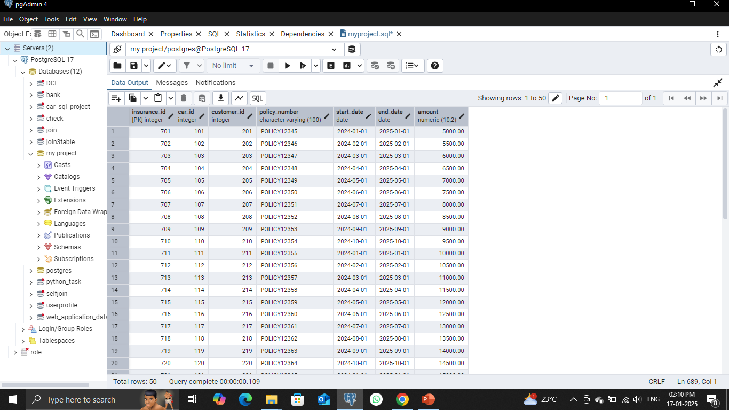
Insurance Expiring This Year:
SELECT * FROM insurance_table WHERE DATE_PART('year', end_date) = DATE_PART
('year’, CURRENT_DATE);
Tracks expiring car insurance policies.

Slide 13
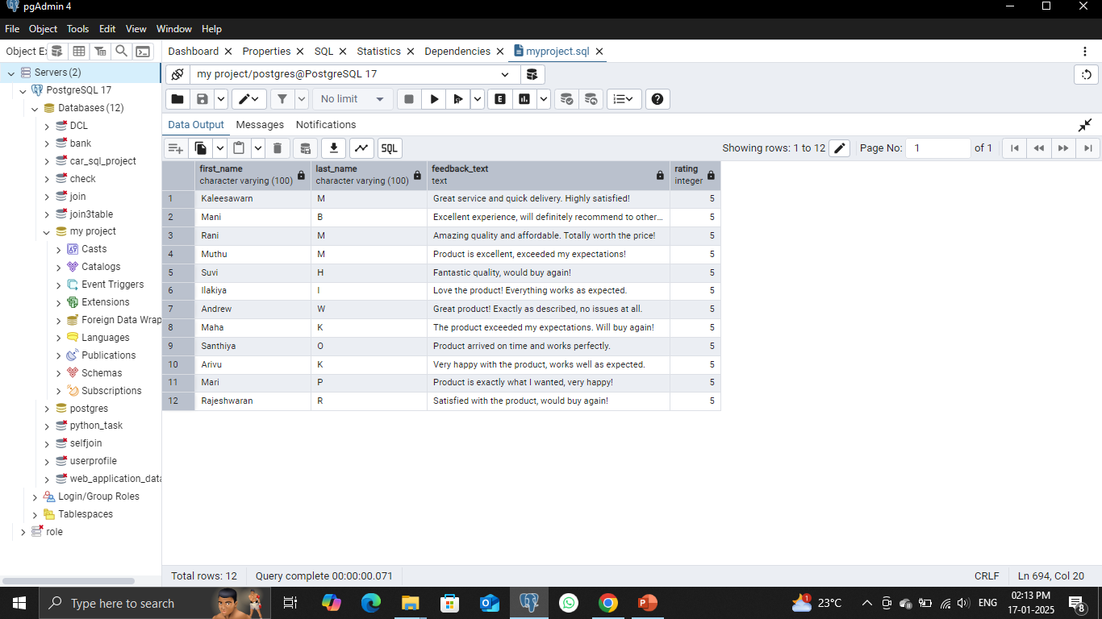
Customer Feedback Above 4 Stars:
SELECT c.first_name, c.last_name, f.feedback_text, f.rating FROM feedback_table f JOIN
customer_table c ON f.customer_id = c.customer_id WHERE f.rating > 4;
Filters positive feedbacK

Slide 14
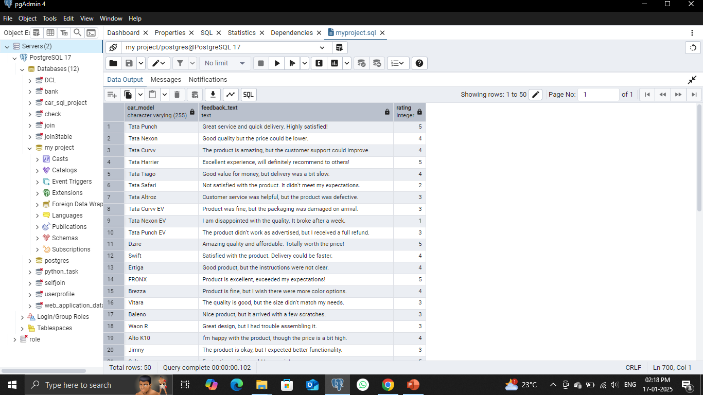
Feedback for Cars Purchased:
SELECT car_model, feedback_text, rating FROM car_table LEFT JOIN sales_table ON car_table.car_id = sales_table.car_id LEFT JOIN feedback_table ON sales_table.customer_id = feedback_table.customer_id;
Combines car models and customer feedback.

Slide 15
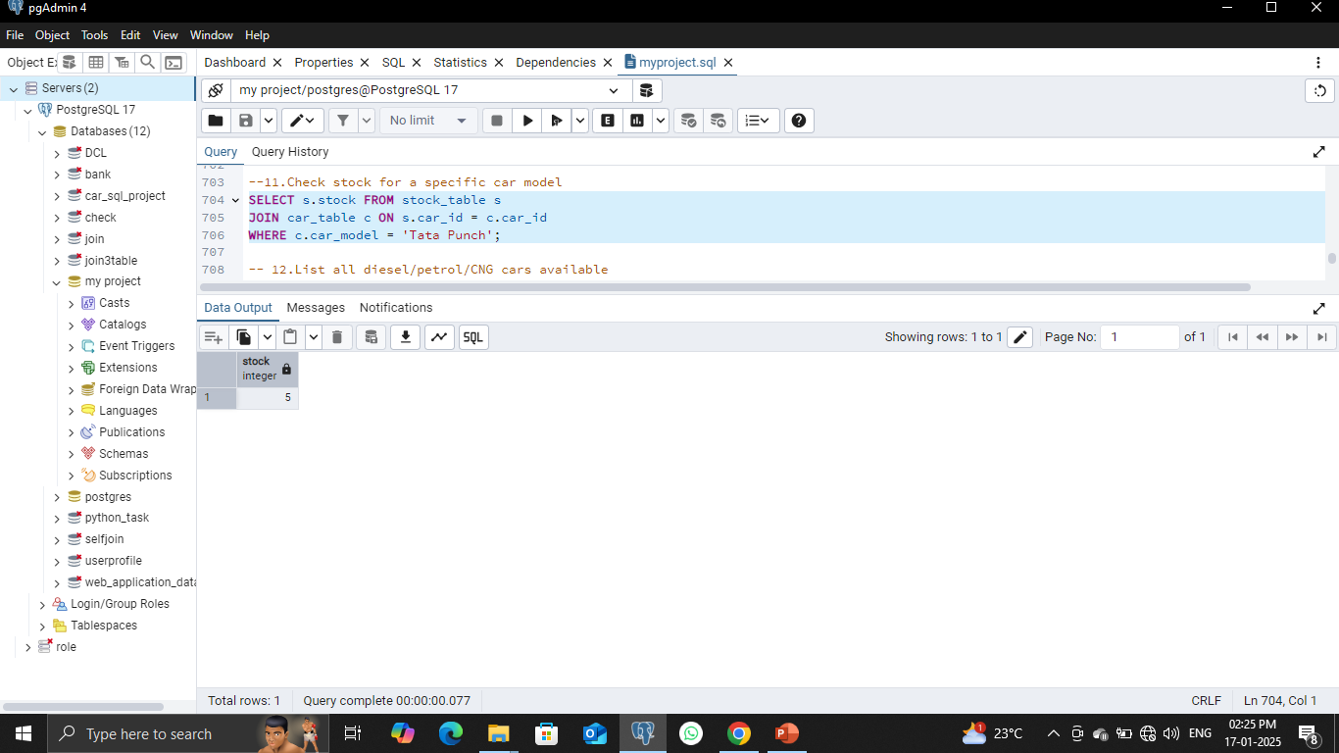
Check Stock for Tata Punch:
SELECT s.stock FROM stock_table s JOIN car_table c ON s.car_id = c.car_id WHERE c.car_model = 'Tata Punch';

Slide 16
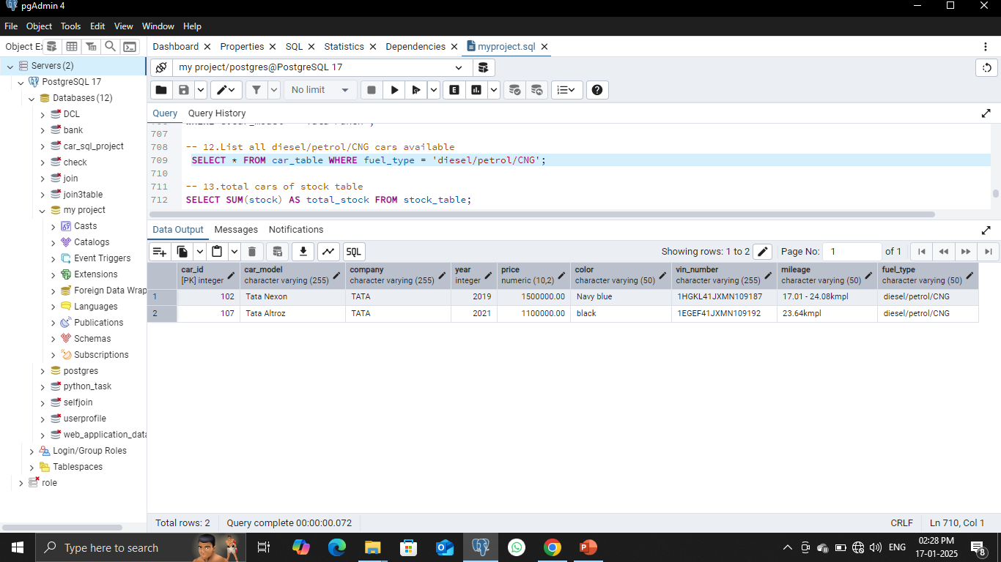
List Diesel, Petrol, or CNG Cars:
SELECT * FROM car_table WHERE fuel_type IN ('diesel', 'petrol', 'CNG');

Slide 17
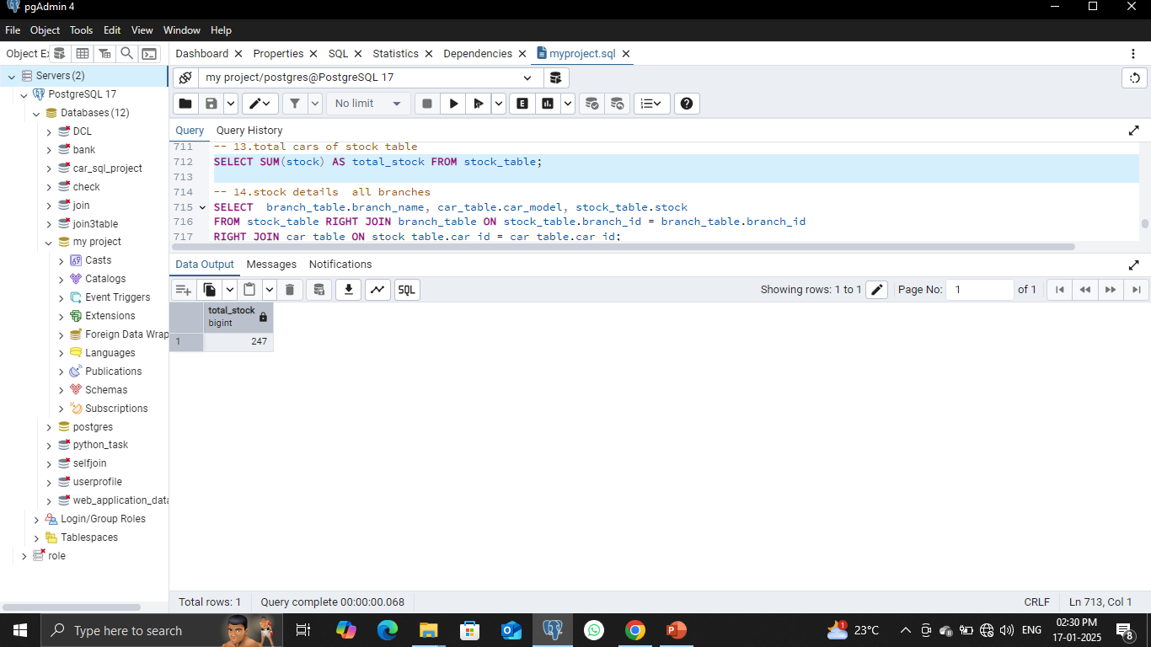
Total Cars in Stock:
SELECT SUM(stock) AS total_stock FROM stock_table;

Slide 18
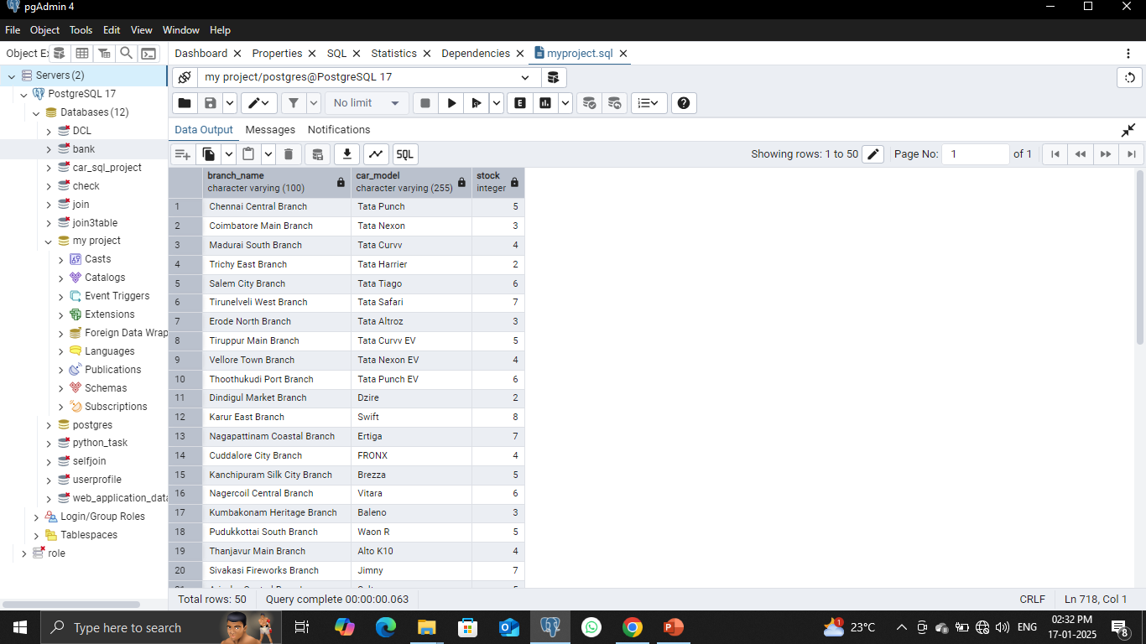
Branch-Wise Stock Details:
SELECT branch_name, car_model, stock FROM stock_table JOIN branch_table ON stock_table.branch_id = branch_table.branch_id JOIN car_table ON
stock_table.car_id = car_table.car_id;

Slide 19
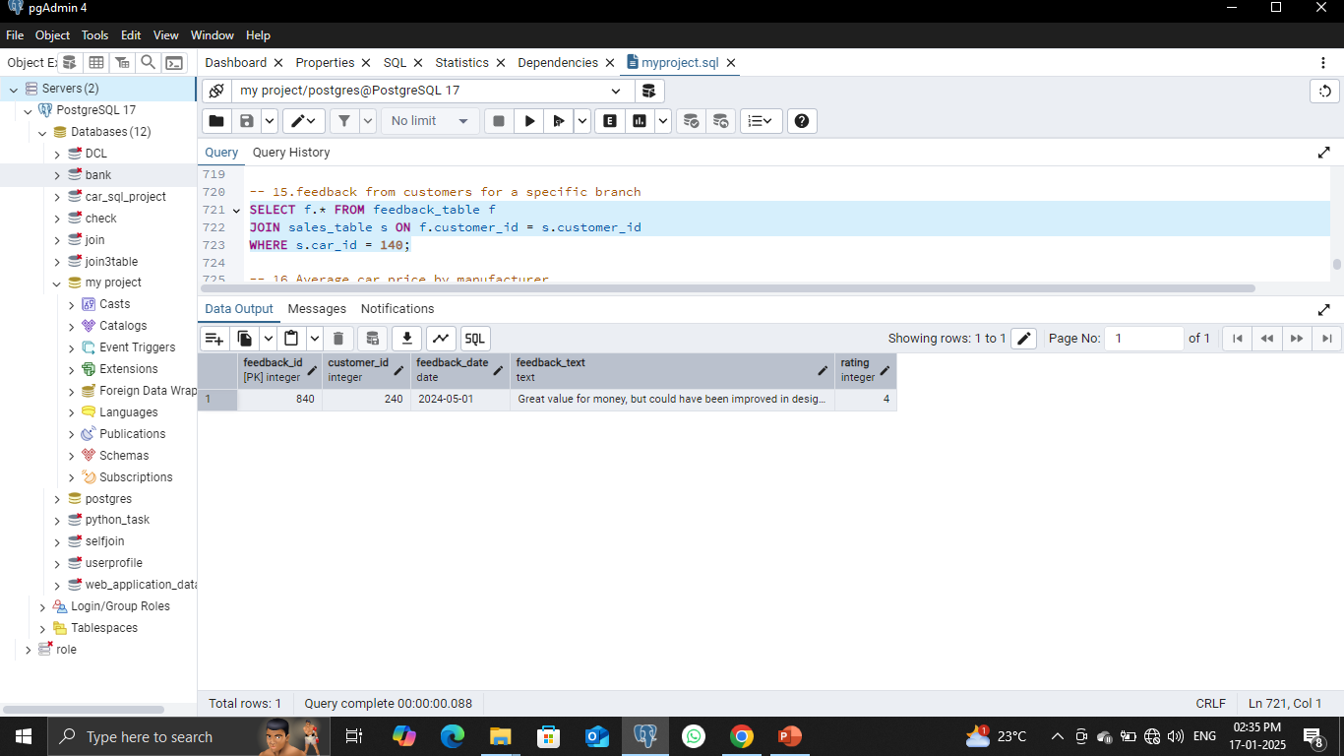
Feedback for a Specific Branch:
SELECT f.* FROM feedback_table f JOIN sales_table s ON f.customer_id = s.customer_id WHERE s.car_id = 140;

Slide 20
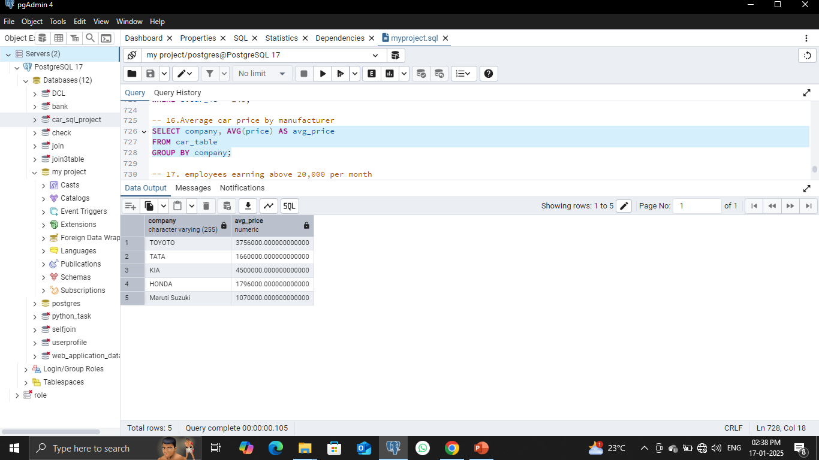
Average Car Price by Manufacturer:
SELECT company, AVG(price) AS avg_price FROM car_table
GROUP BY company;

Slide 21
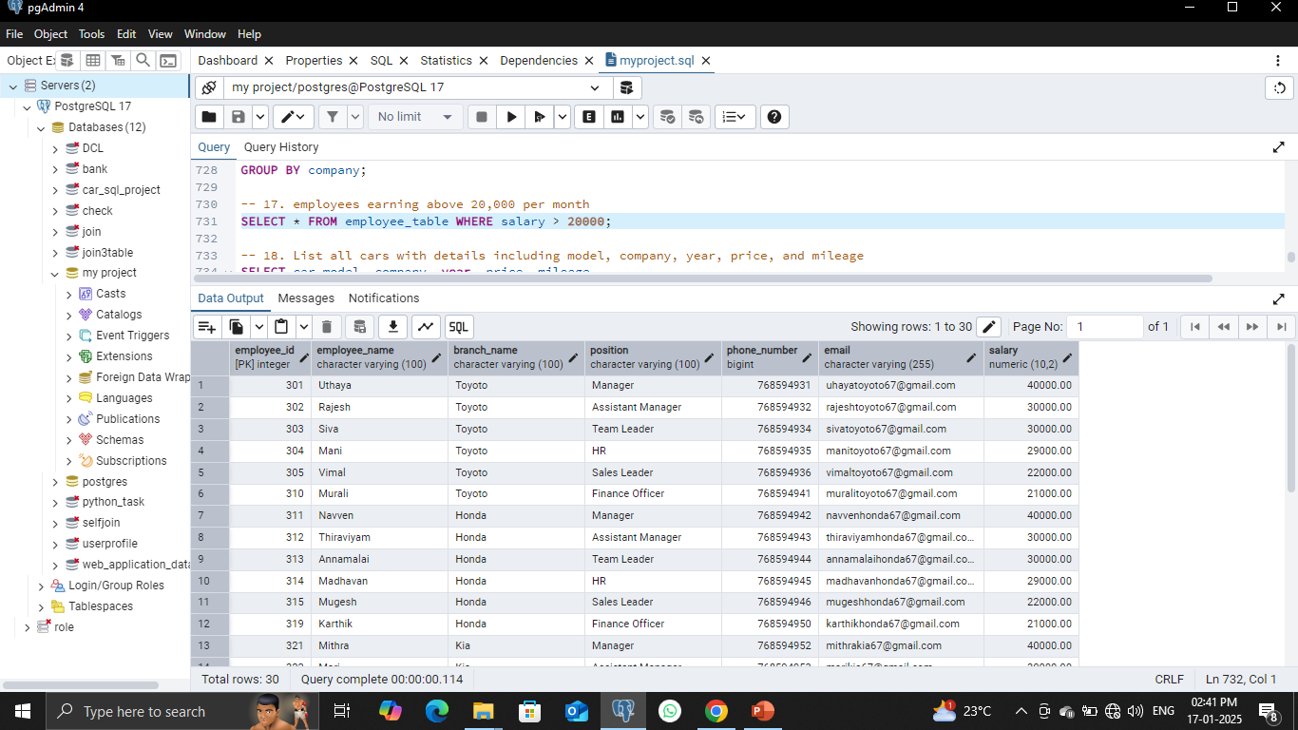
Employees Earning Above ₹20,000:
SELECT * FROM employee_table WHERE salary > 20000;

Slide 22
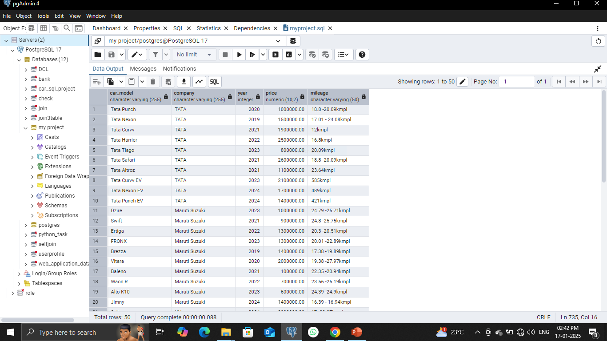
List All Cars (Details):
SELECT car_model, company, year, price, mileage FROM car_table;

Slide 23
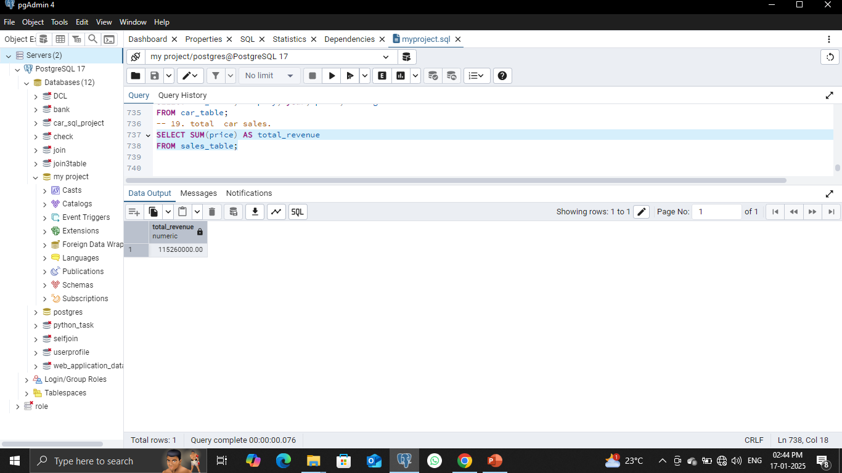
Total Revenue from Sales:
SELECT SUM(price) AS total_revenue FROM sales_table;

Slide 24
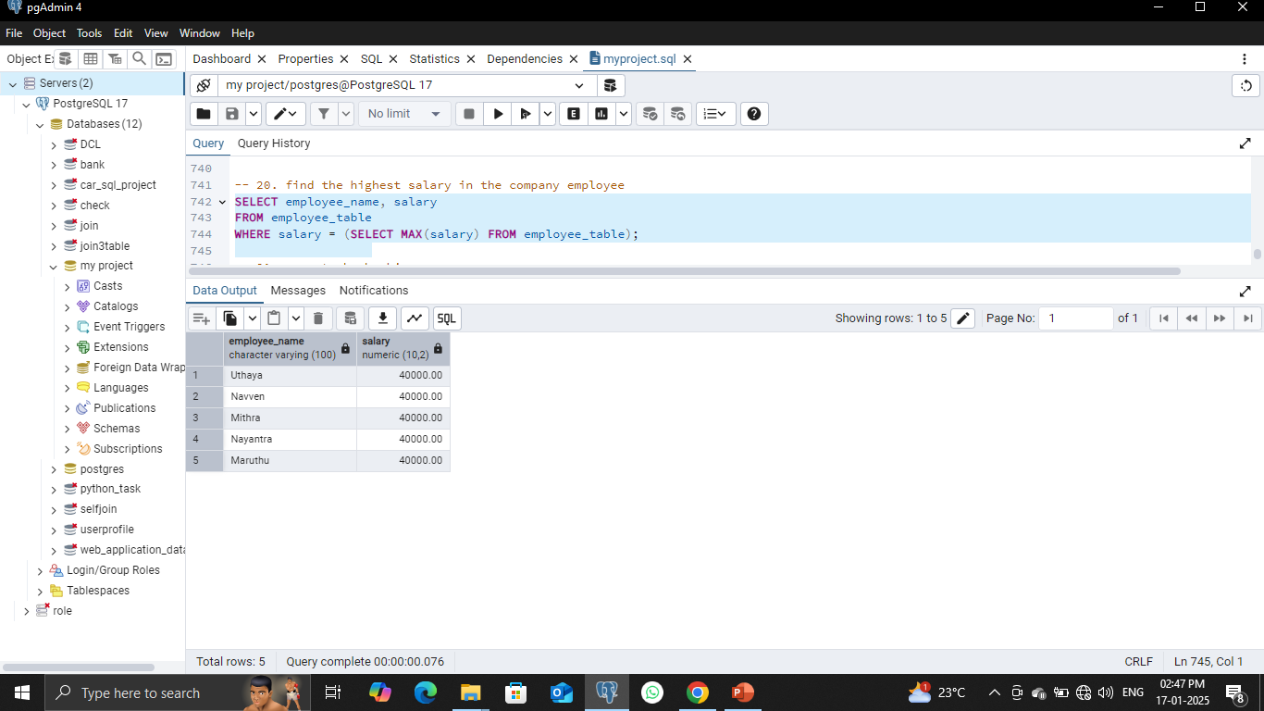
Highest Employee Salary:
SELECT employee_name, salary FROM employee_table WHERE
salary = (SELECT MAX(salary) FROM employee_table);

Slide 25
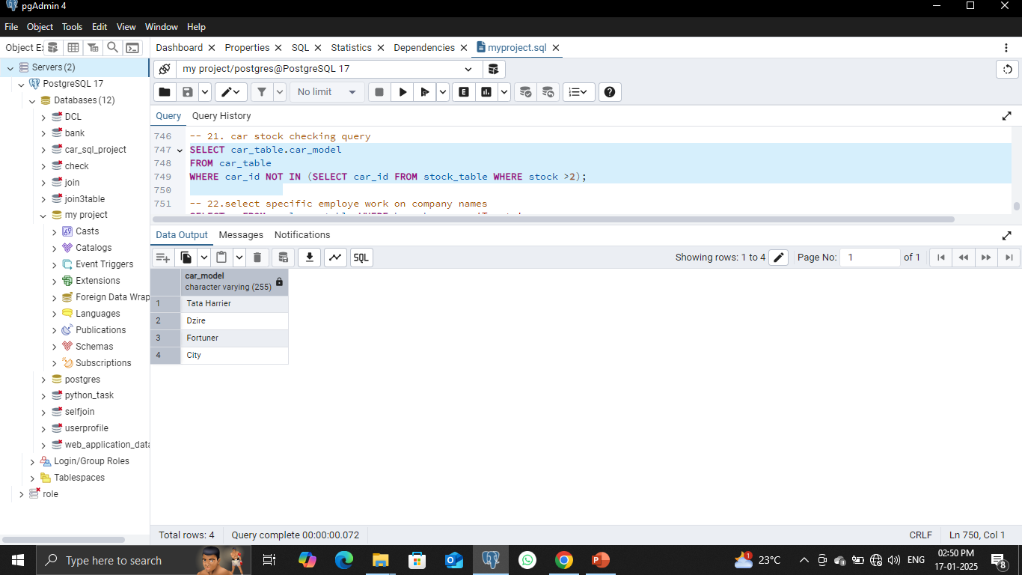
Check Stock for Cars Not in Inventory:
SELECT car_model FROM car_table WHERE car_id NOT IN (SELECT car_id FROM stock_table WHERE stock > 2);

Slide 26
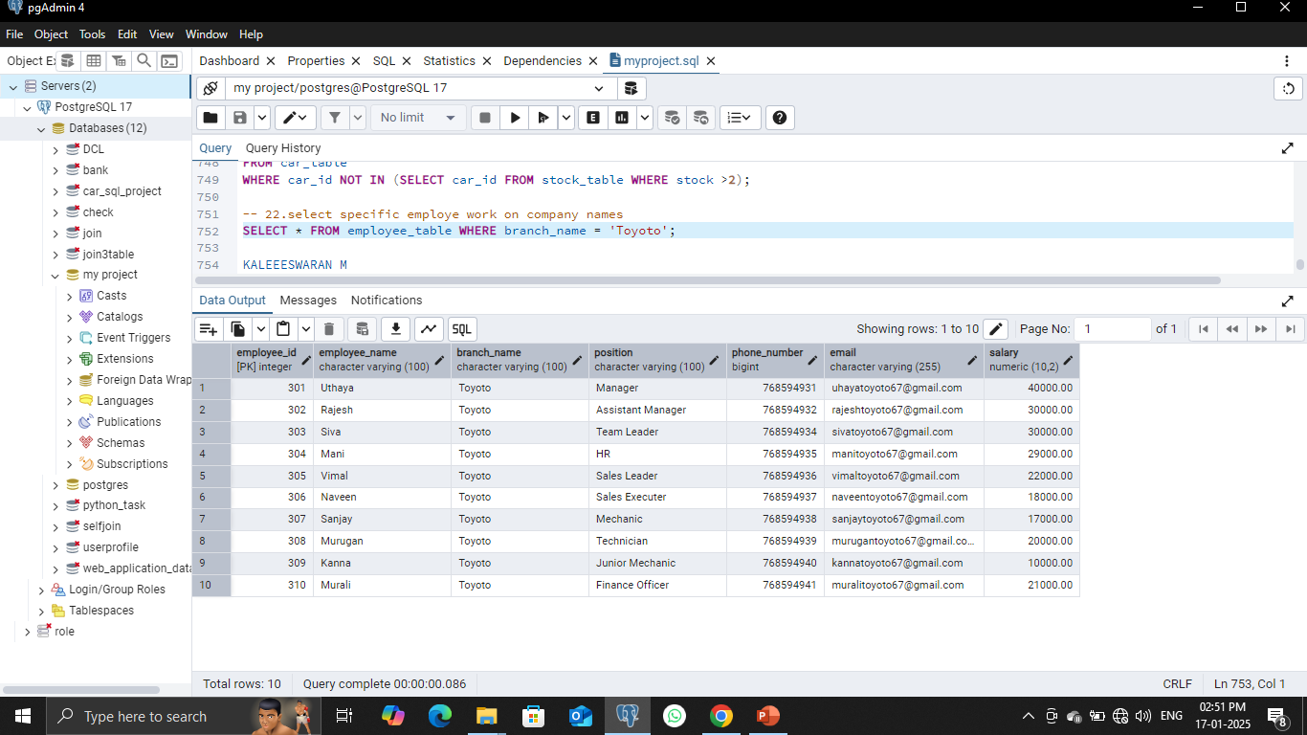
Employees at a Specific Branch:
SELECT * FROM employee_table WHERE branch_name = 'Toyota';

Slide 27
Conclusion
Key Insights:
Comprehensive management of cars, customers, employees, sales, and services.
Queries provide actionable insights for business decisions.
Future Scope:
Add modules for online booking and delivery.
Enhance analytics with machine learning.

Slide 28
THANK YOU……

